Slide 1

RaceCraft Prodigy
F1 Winner Predictor
Luna Dana, Idriss Kadiri, Raphael Barthes, Jacob Grayzel

Slide 2
TABLE OF CONTENTS
01
Data Scraping and Cleaning
02
Exploratory Data Analysis
03
Our
Modeling
04
Our
Results

Slide 3
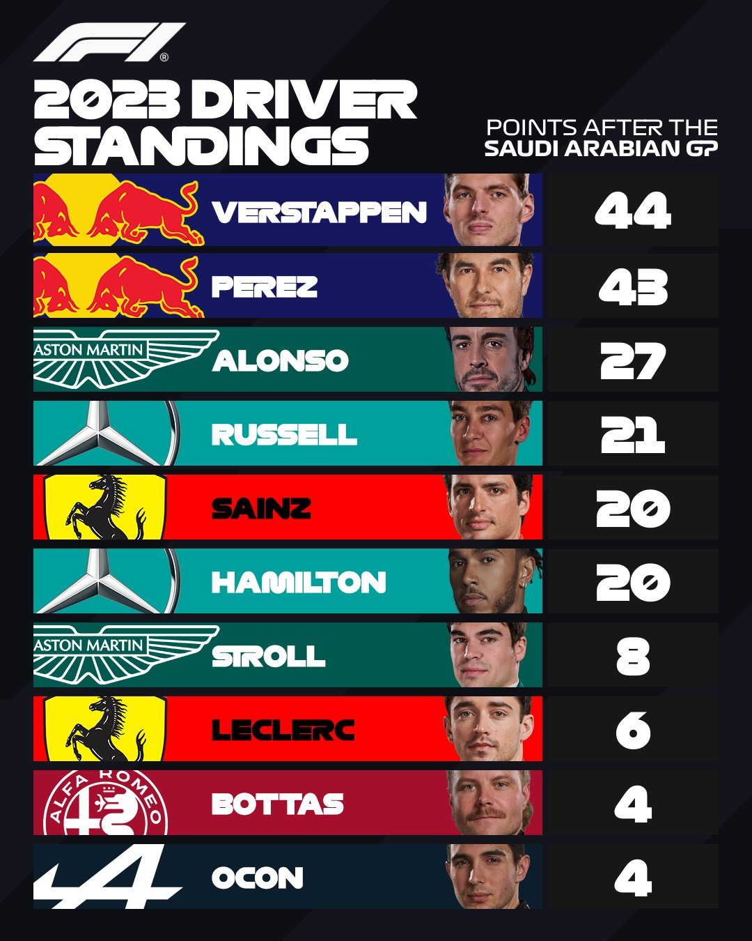
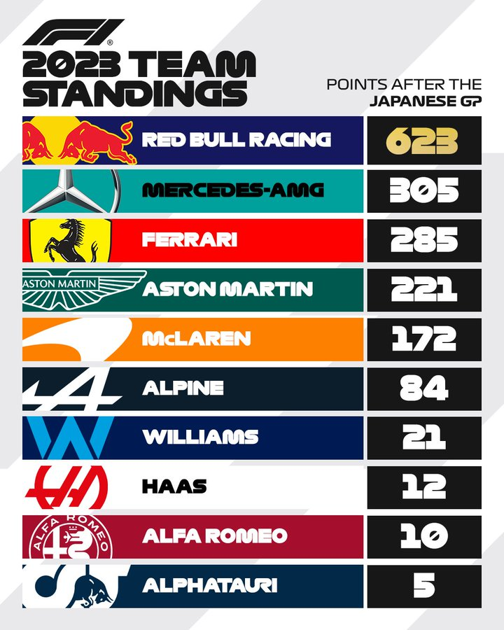
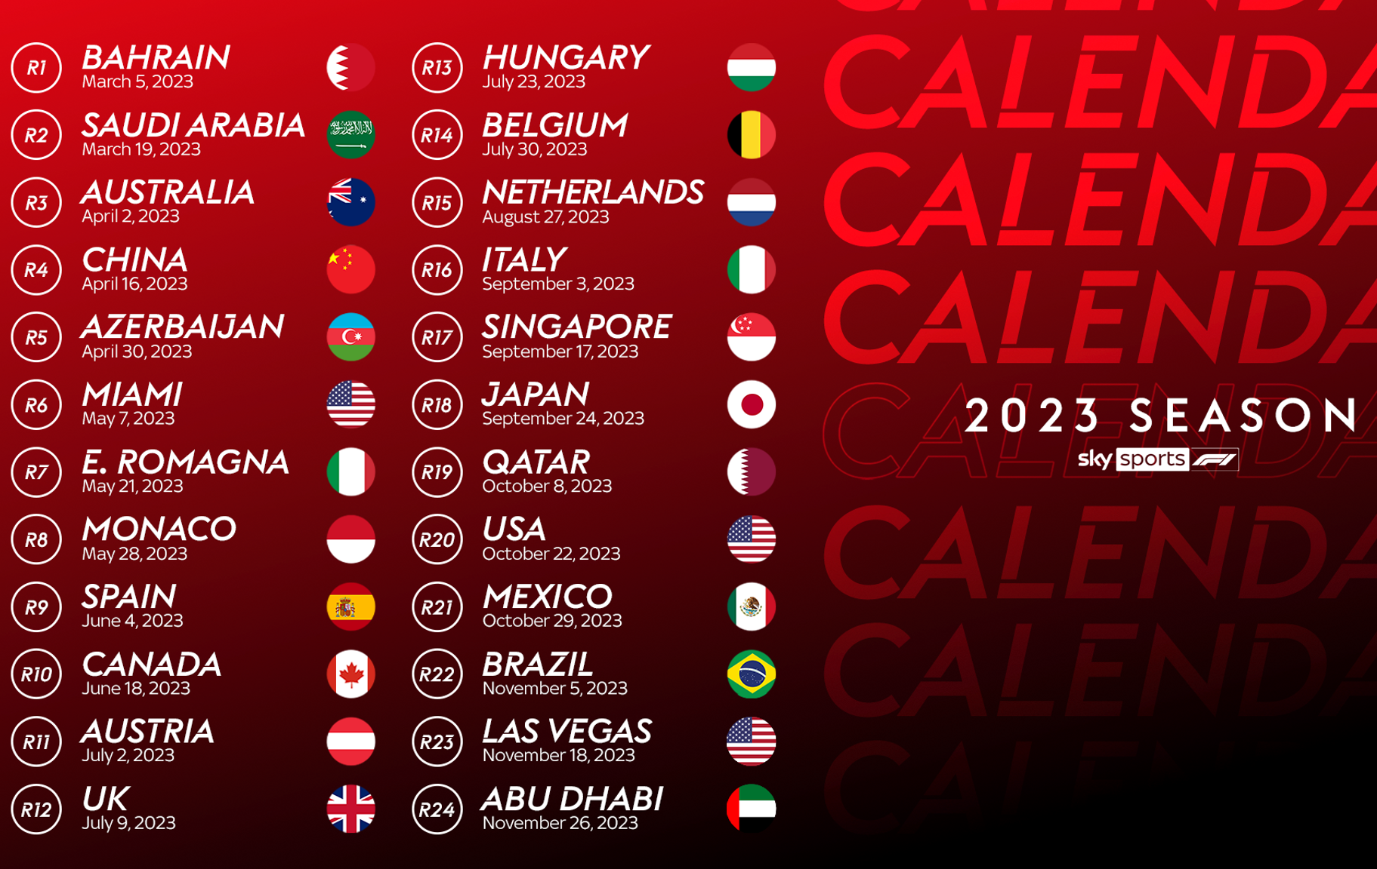
F1 - Rules
10 teams, 2 drivers = 20 drivers total
Different circuits worldwide
2 Championships
Driver
Constructor
3 Days of competiton
Friday: Training
Saturday: Qualifying
Sunday: Race Day!!

Slide 4
Project
Progress
Data Scraping and Cleaning
Modelling
STEP 1
STEP 3
STEP 2
STEP 4
Exploratory Data Analysis
Analysis of Results

Slide 5
Datasets
Race
Results
Driver Standing
Information about each Formula 1 race (loc, date)
Detailed race results, including driver and constructor information
Cumulative driver standings across seasons, providing insights into the consistent performance of drivers over time
Constructor standing
Qualifying Results
Similar to driver standings, but focused on constructor (team) performance, offering valuable information for predicting team success
Information about drivers' grid positions and qualifying times, providing insights into individual driver performance during the qualifying sessions
Weather Information
Weather conditions for each race, which can have a significant impact on race strategies and outcomes.

Slide 6
Project
Progress
Data Scraping and Cleaning
Modelling
STEP 1
STEP 3
STEP 2
STEP 4
Exploratory Data Analysis
Analysis of Results

Slide 7
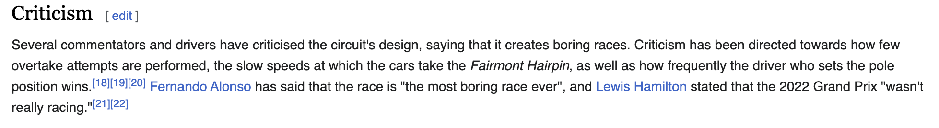
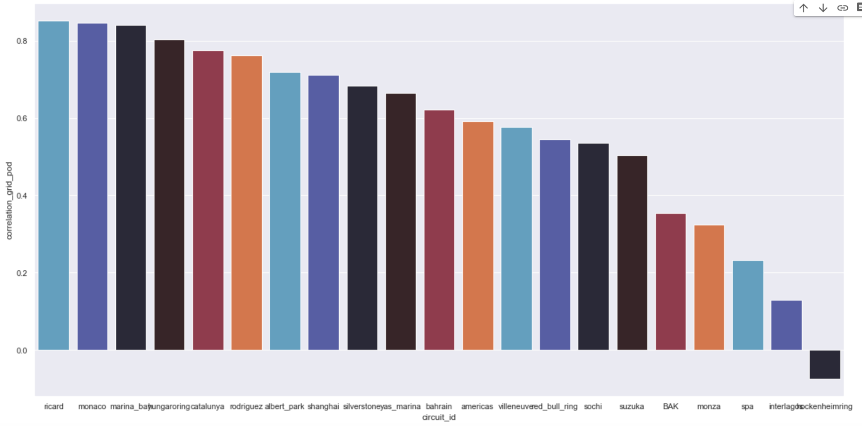
Exploratory Data Analysis
Correlation between start grid and finish ranking
Corr = 80%

Slide 8
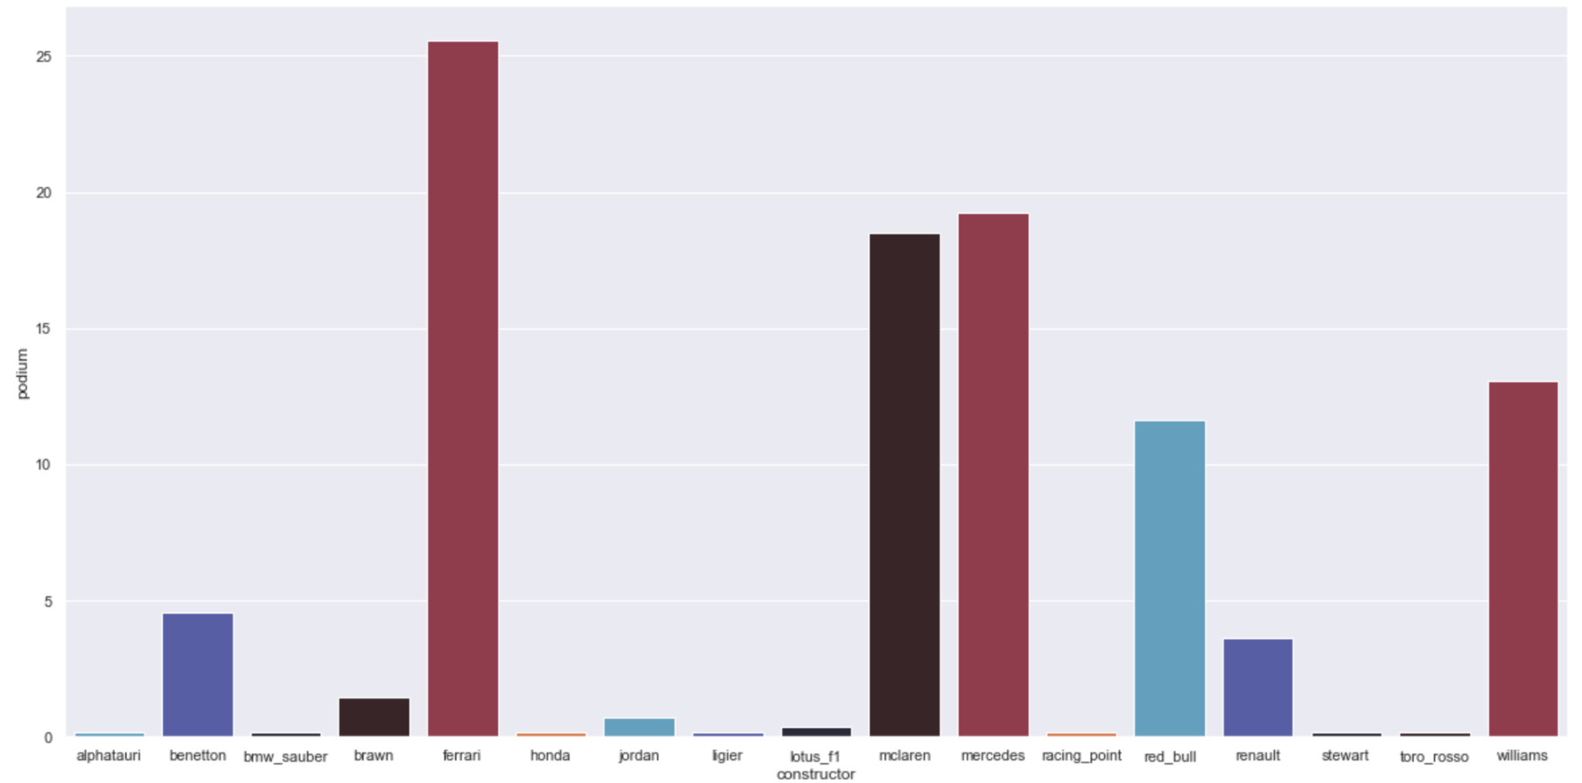
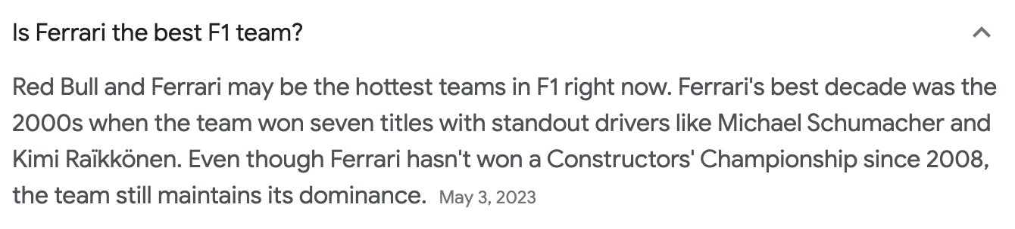
Exploratory Data Analysis
Correlation between manufacturer and grid and finish ranking
7.43

Slide 9
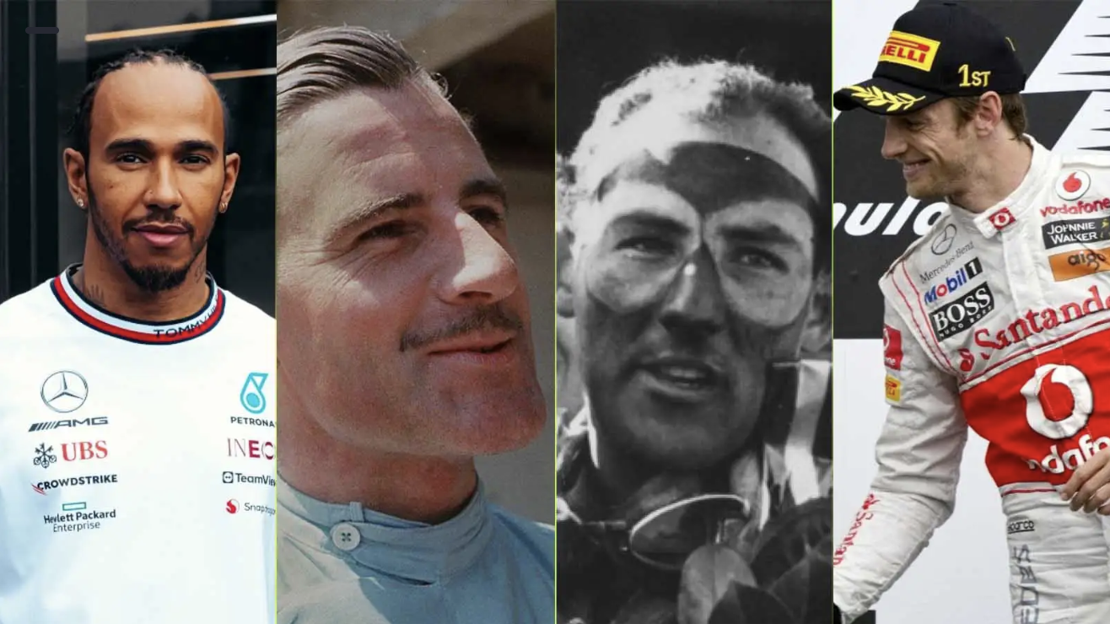
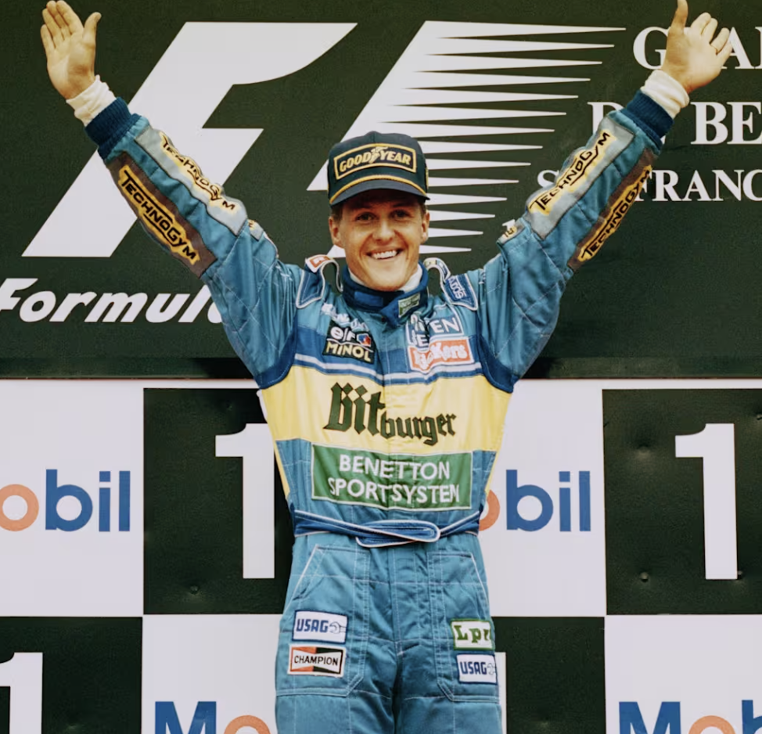
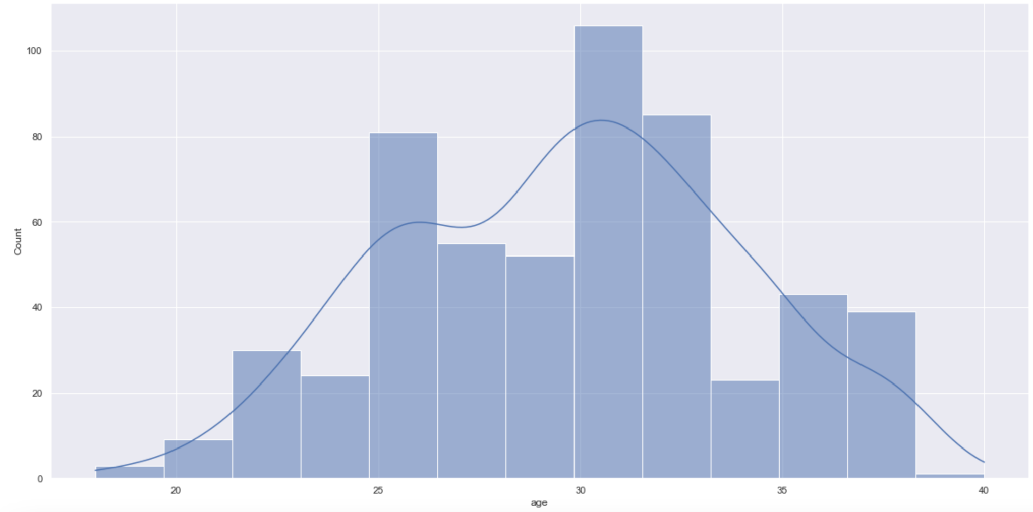
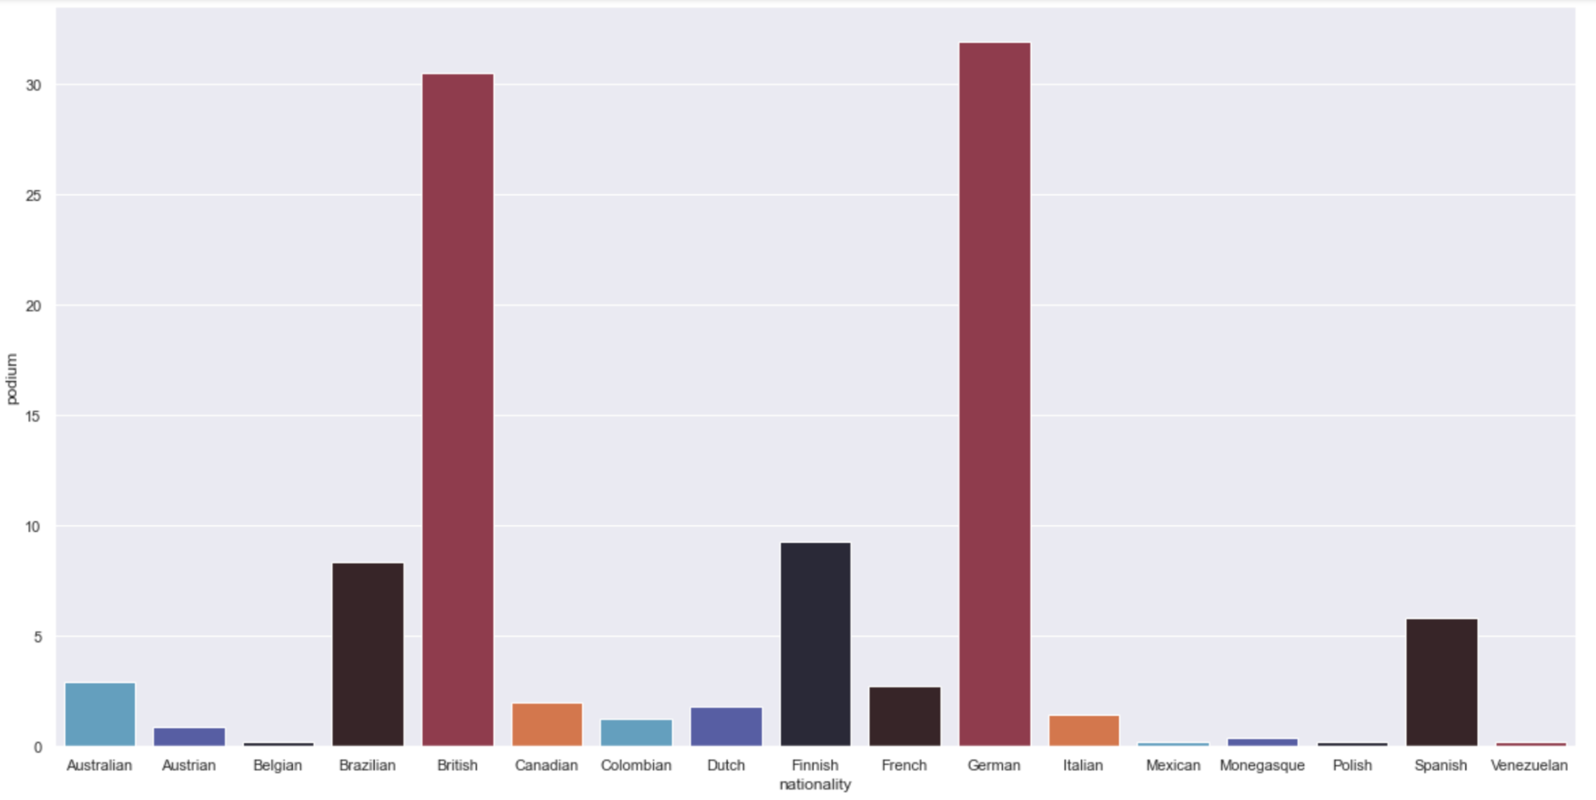
Exploratory Data Analysis
Correlation between driver and final victory

Slide 10
Project
Progress
Data Scraping and Cleaning
Modelling
STEP 1
STEP 3
STEP 2
STEP 4
Exploratory Data Analysis
Analysis of Results

Slide 11
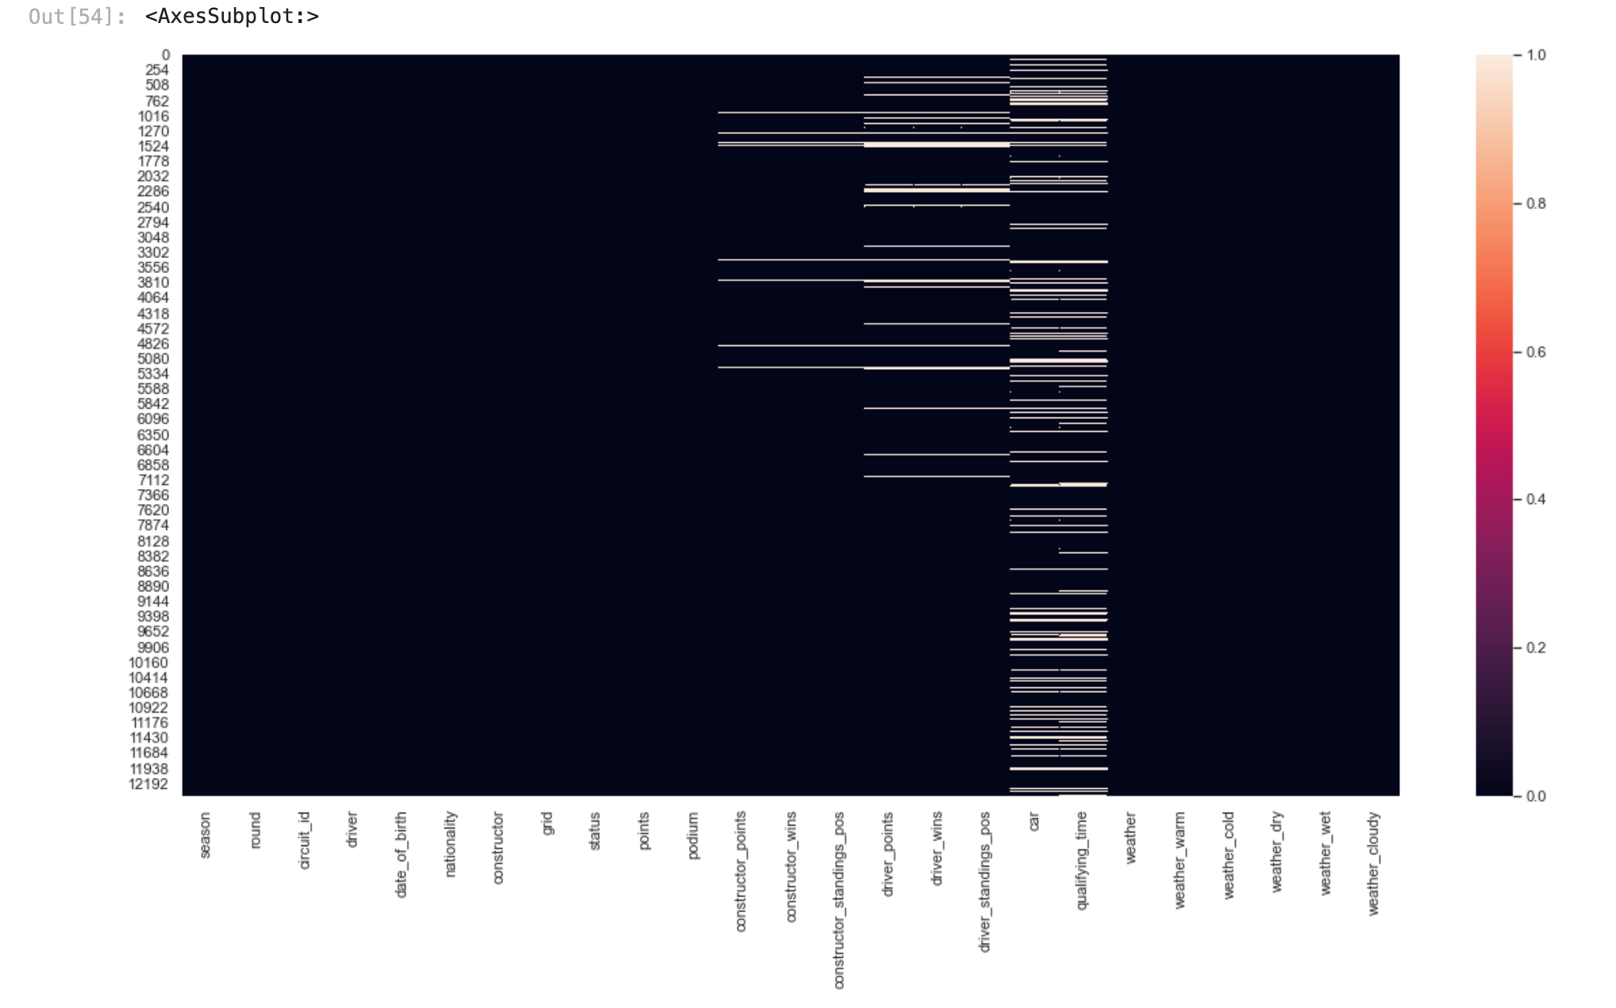
Data Preparation
Transformed raw data into features suitable for modeling
Merging Dataframes
Handling Missing Values
Normalization & Standardization
Categorical variables handling
Creating New Variables

Slide 12


Modeling
Neural Network
SVM
Linear
Regression
popular choice for solving classification problems. To optimize the model, we experimented with different parameter combinations, despite the computational intensity of this process.
Predict the winner as the one with the lowest ranking. Suitability in modeling continuous outcomes and interpreting relationships between variables.

Slide 13
Details
Evaluation
Batch normalization and dropout for neural networks to improve convergence and reduce overfitting
Cross-validation techniques to assess the generalizability and robustness of our models
Classification
Accuracy
Precision
Recall
F1-score
Regression
Mean squared error (MSE)
R-squared

Slide 14
Project
Progress
Data Scraping and Cleaning
Modelling
STEP 1
STEP 3
STEP 2
STEP 4
Exploratory Data Analysis
Analysis of Results

Slide 15
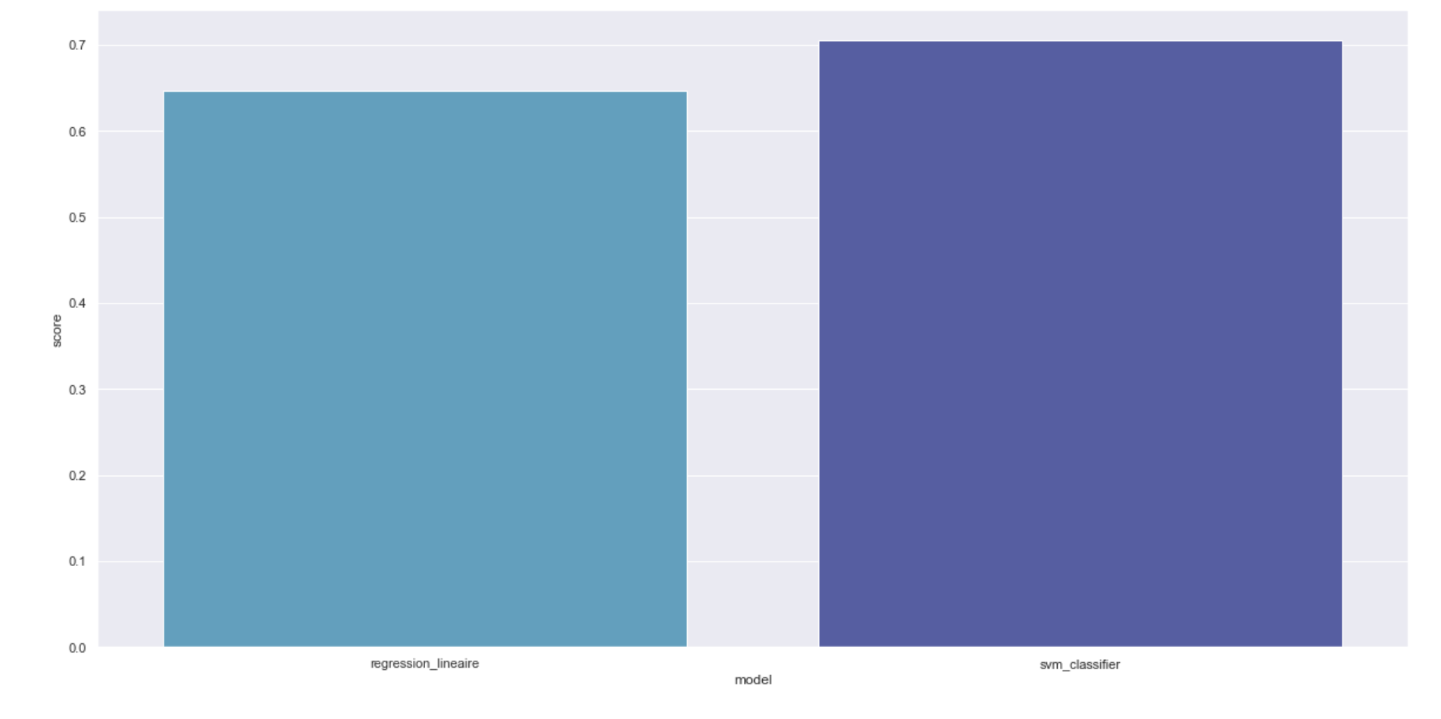
Results
Linear
Regresion
~0.64
SVM
~0.71

Slide 16
THANKS!
Do you have any questions?

